Slide 1
Mining useful information from exact diagonalization ground state
汪 士
2020年4月15日

Slide 2
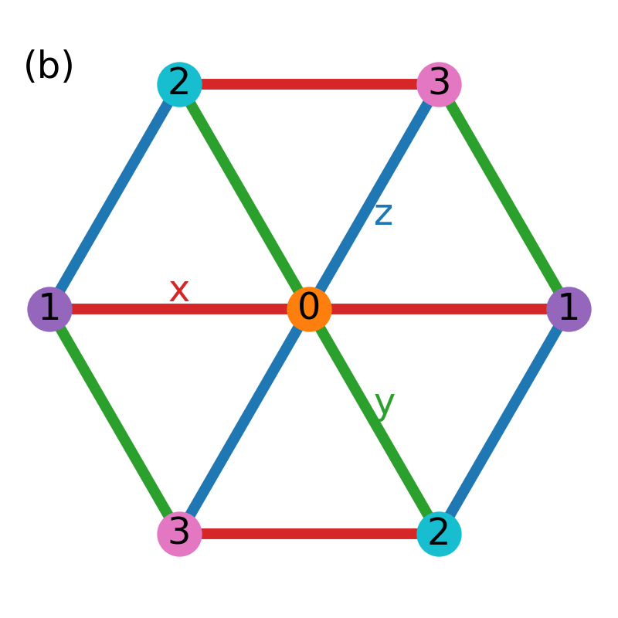
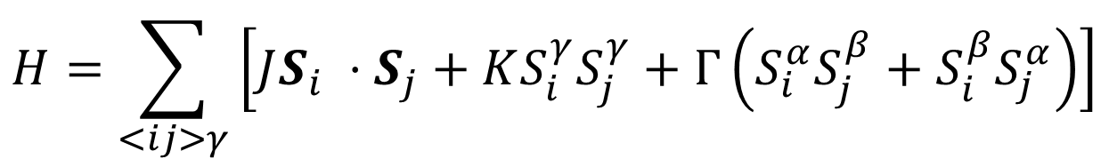
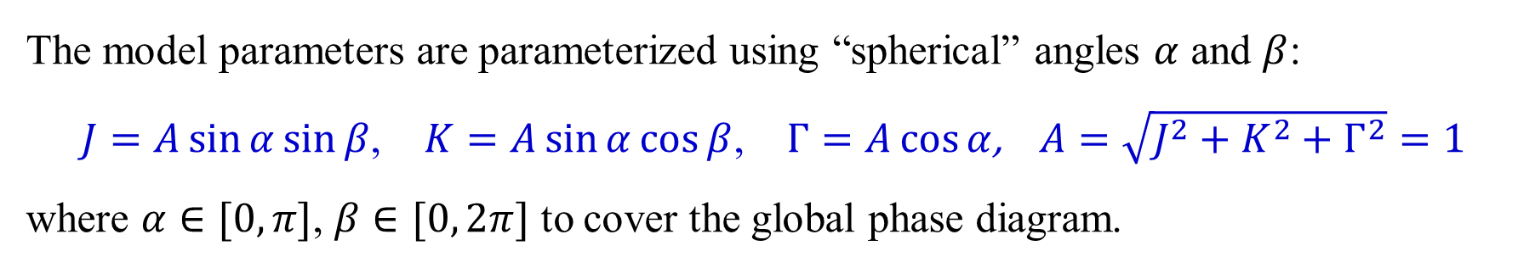
$J−K−Γ$ model on triangular lattice
$$H=\sum_{<ij>γ}{\left[JS_{i} ⋅S_{j}+KS_{i}^{γ}S_{j}^{γ}+Γ\left(S_{i}^{α}S_{j}^{β}+S_{i}^{β}S_{j}^{α}\right)\right]}$$
The model parameters are parameterized using “spherical” angles $α$ and $β$:
$J=A\sin{α}\sin{β}$, $K=A\sin{α}\cos{β}$, $Γ=A\cos{α}$, $A=\sqrt{J^{2}+K^{2}+Γ^{2}}=1$
where $α∈[0, π]$, $β∈[0, 2π]$ to cover the global phase diagram.

Slide 3
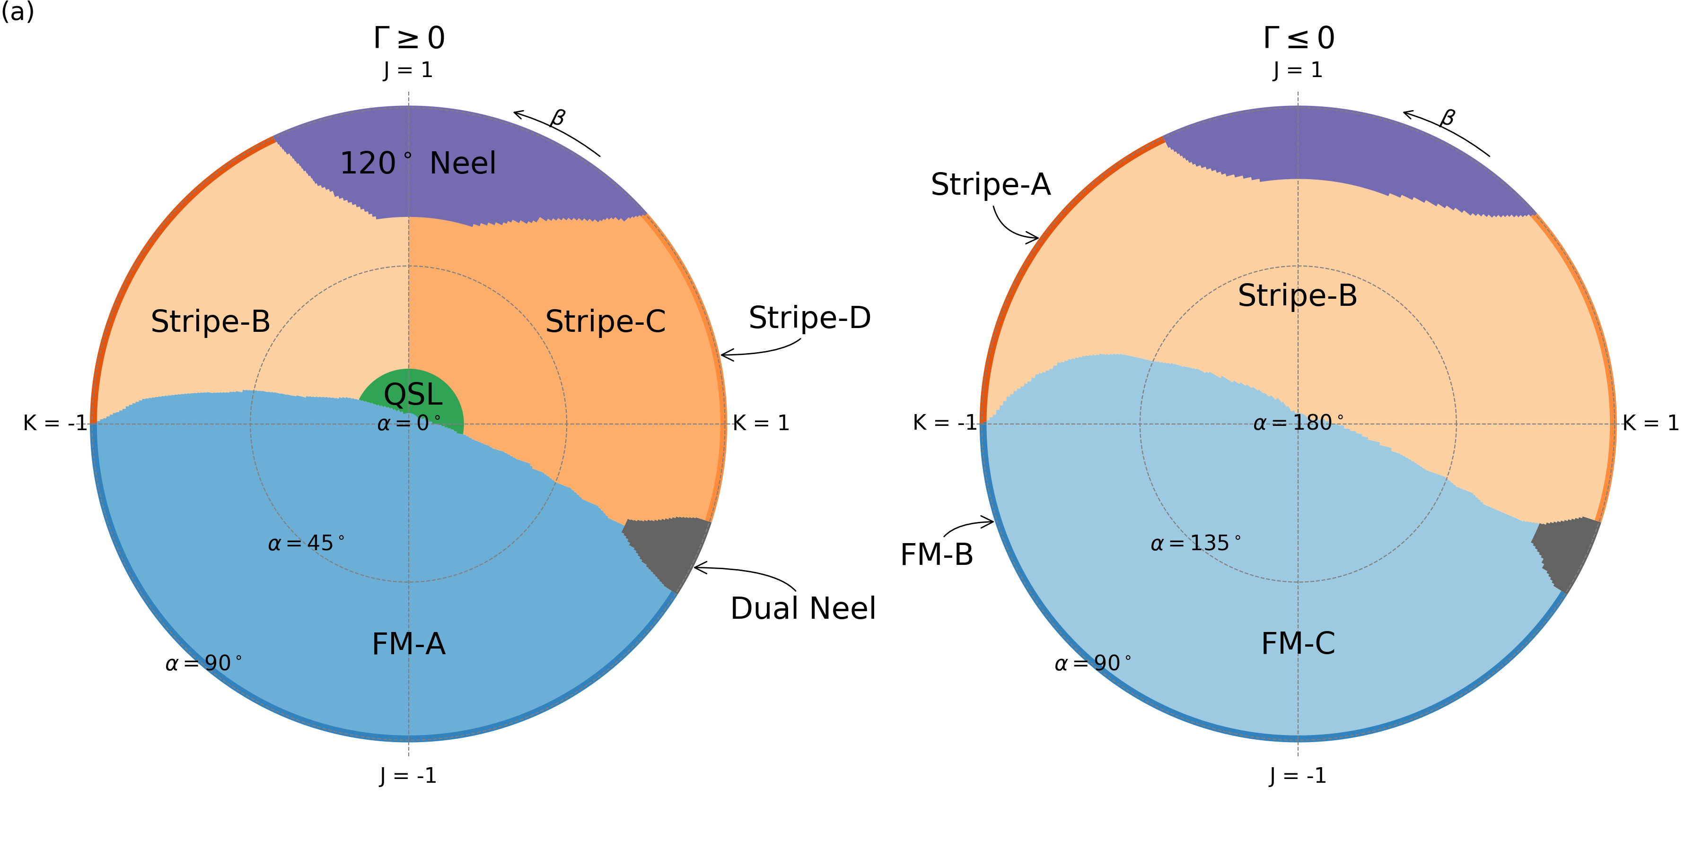
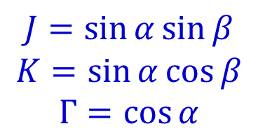
Global Phase Diagram
$$J=\sin{α}\sin{β}$$
$$K=\sin{α}\cos{β}$$
$$Γ=\cos{α}$$

Slide 4
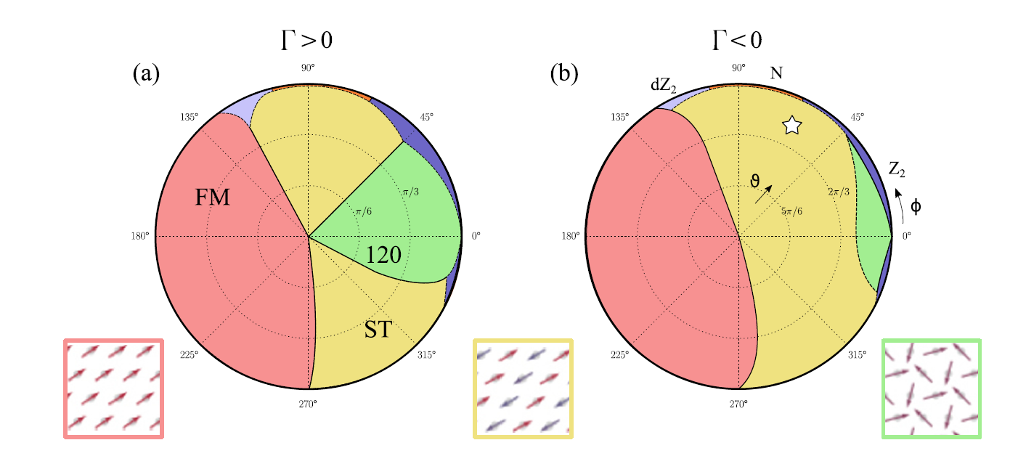
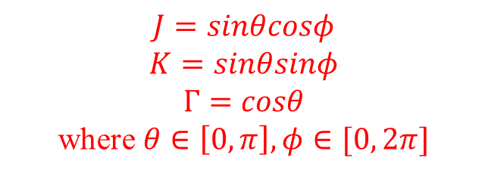
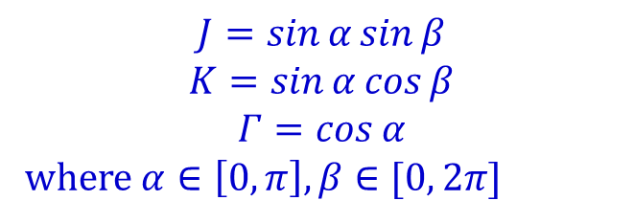
Classical Phase Diagram
$$J=sinθcosφ$$
$$K=sinθsinφ$$
$$Γ=cosθ$$
where $θ∈\left[0,π\right], φ∈[0, 2π]$
$$J=\sin{α}\sin{β}$$
$$K=\sin{α}\cos{β}$$
$$Γ=\cos{α}$$
where $α∈\left[0,π\right], β∈[0, 2π]$
A. Catuneanu et al., Phys. Rev. B 92, 165108 (2015)

Slide 5
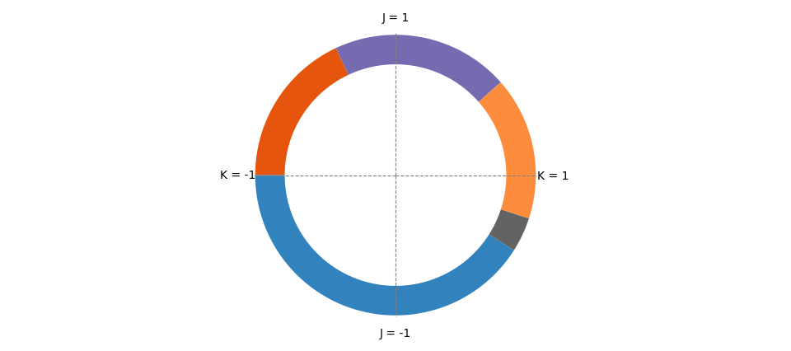
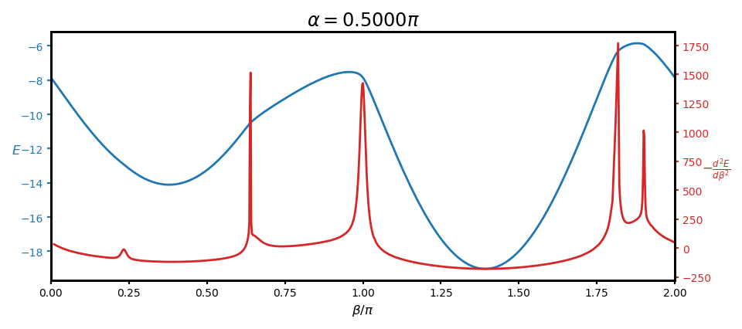
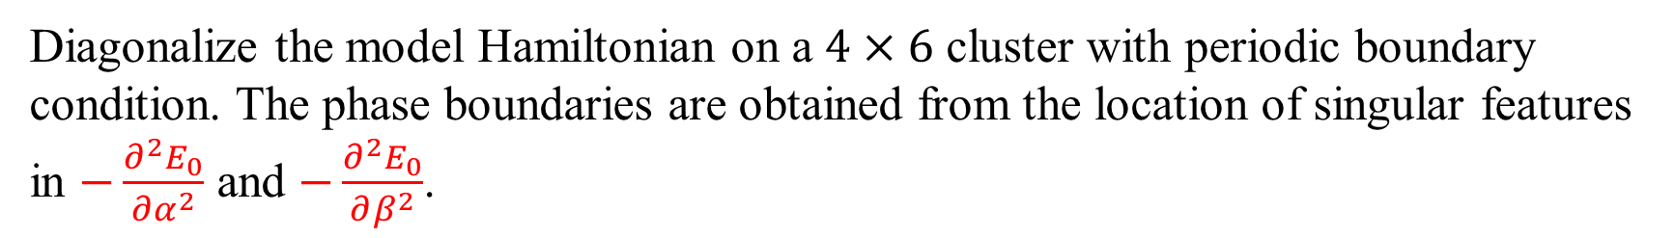
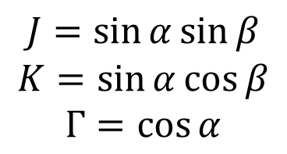
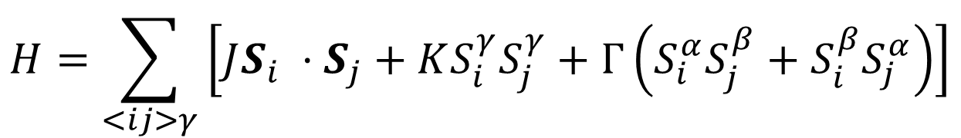
Phase boundary
Diagonalize the model Hamiltonian on a $4×6$ cluster with periodic boundary condition. The phase boundaries are obtained from the location of singular features in $−\frac{∂^{2}E_{0}}{∂α^{2}}$ and $−\frac{∂^{2}E_{0}}{∂β^{2}}$.
$$H=\sum_{<ij>γ}{\left[JS_{i} ⋅S_{j}+KS_{i}^{γ}S_{j}^{γ}+Γ\left(S_{i}^{α}S_{j}^{β}+S_{i}^{β}S_{j}^{α}\right)\right]}$$
$$J=\sin{α}\sin{β}$$
$$K=\sin{α}\cos{β}$$
$$Γ=\cos{α}$$

Slide 6
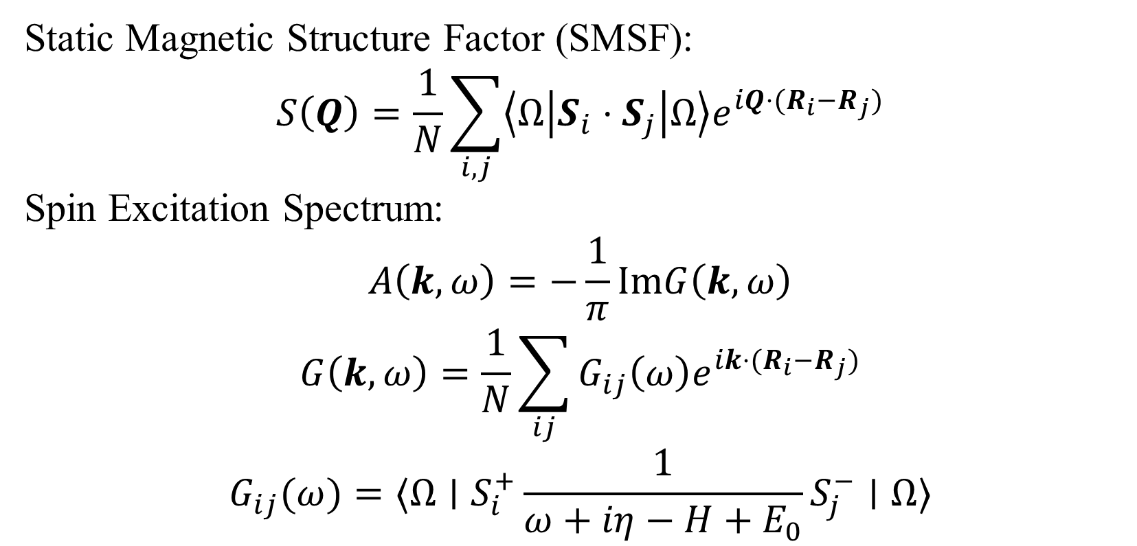
SMSF and $A(k, ω)$
Static Magnetic Structure Factor (SMSF):
$$S\left(Q\right)=\frac{1}{N}\sum_{i,j}{\left\langle Ω\left|S_{i}⋅S_{j}\right|Ω\right\rangle e^{iQ⋅(R_{i}−R_{j})}}$$
Spin Excitation Spectrum:
$$A\left(k, ω\right)=−\frac{1}{π}ImG\left(k, ω\right)$$
$$G\left(k, ω\right)=\frac{1}{N}\sum_{ij}{G_{ij}\left(ω\right)e^{ik⋅(R_{i}−R_{j})}}$$
$$G_{ij}(ω)=⟨Ω∣S_{i}^{+}\frac{1}{ω+iη−H+E_{0}}S_{j}^{−}∣Ω⟩$$

Slide 7
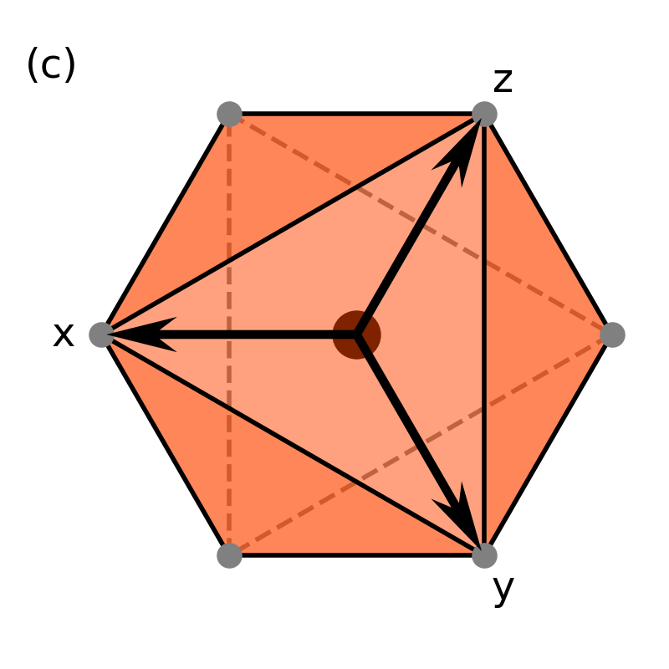
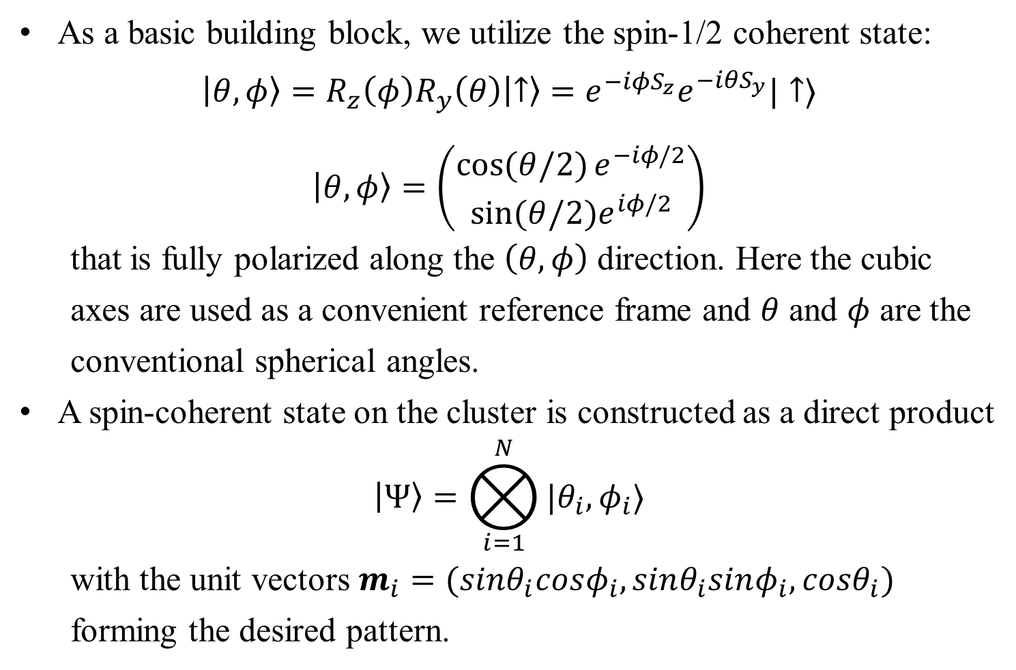
Cluster Spin-Coherent State
As a basic building block, we utilize the spin-1/2 coherent state:
$$\left|θ,φ\right\rangle =R_{z}\left(φ\right)R_{y}\left(θ\right)\left|↑\right\rangle =e^{−i{φS}_{z}}e^{−iθS_{y}}|↑⟩$$
$$\left|θ,φ\right\rangle =\left(\begin{matrix}\cos{(θ/2)}e^{−iφ/2} \\ sin⁡(θ/2)e^{iφ/2}\end{matrix}\right)$$
that is fully polarized along the $\left(θ,φ\right)$ direction. Here the cubic axes are used as a convenient reference frame and $θ$ and $φ$ are the conventional spherical angles.
A spin-coherent state on the cluster is constructed as a direct product
$$\left|Ψ\right\rangle =⨂_{i=1}^{N}{|θ_{i},φ_{i}⟩}$$
with the unit vectors $m_{i}=(sinθ_{i}cosφ_{i}, sinθ_{i}sinφ_{i}, cosθ_{i})$ forming the desired pattern.
J. Chaloupka and G. Khaliullin, Phys. Rev. B 94, 064435 (2016)

Slide 8
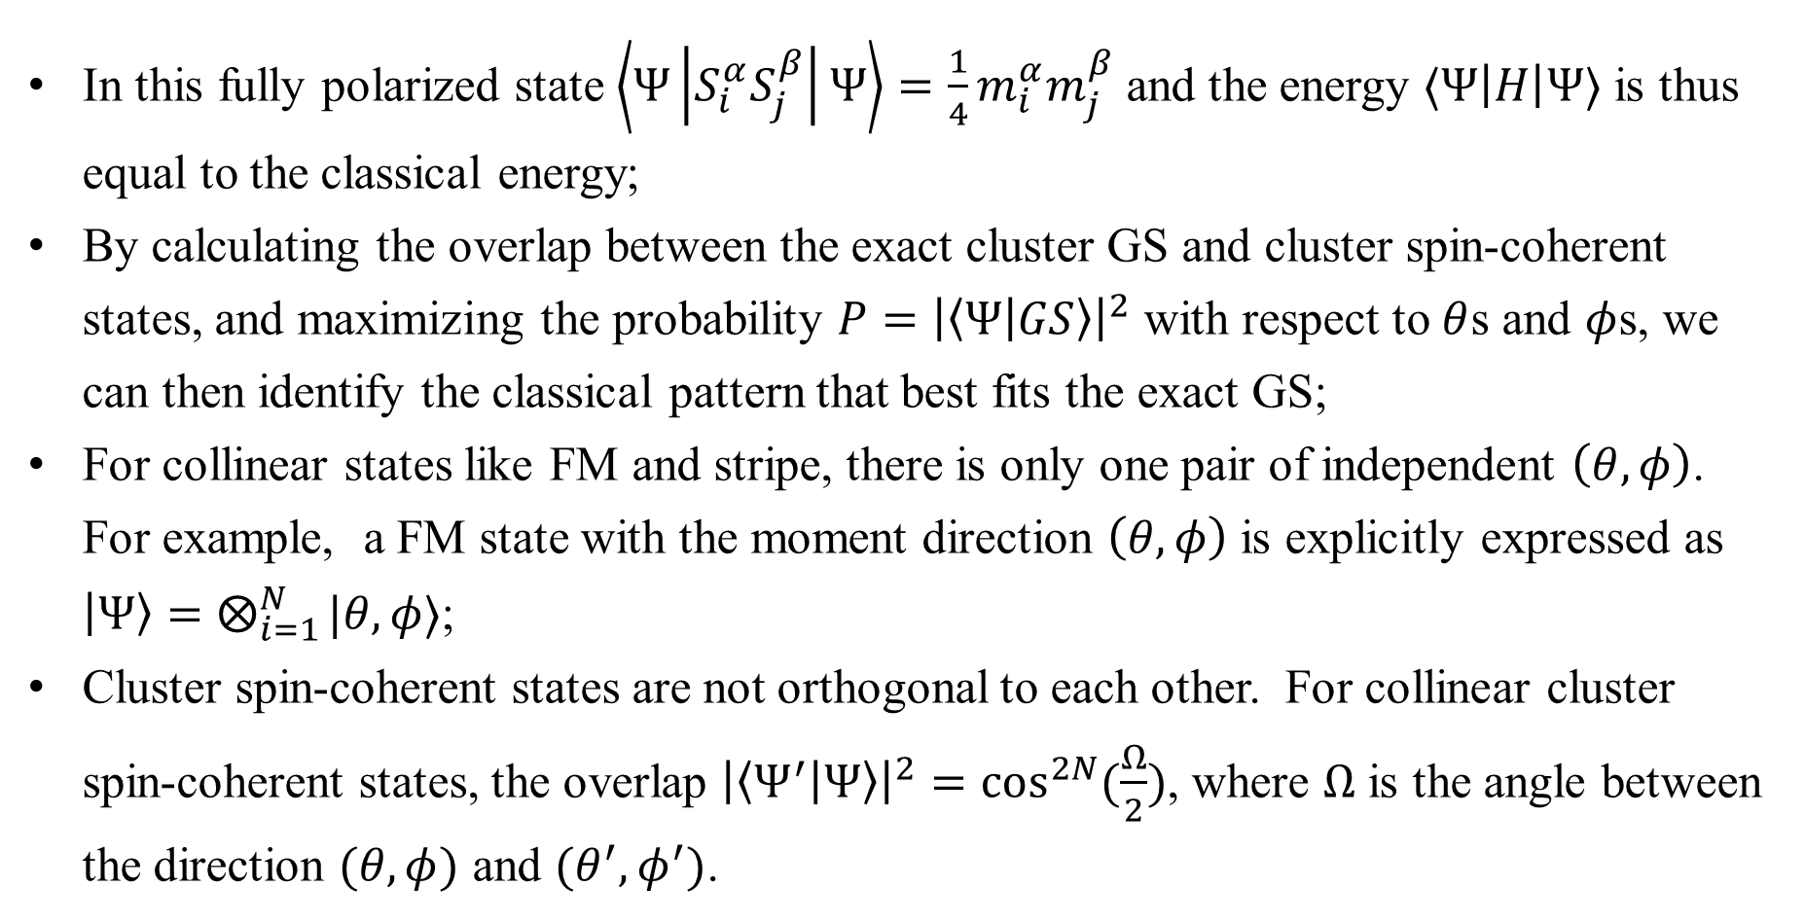
Cluster Spin-Coherent State
In this fully polarized state $\left\langle Ψ\left|S_{i}^{α}S_{j}^{β}\right|Ψ\right\rangle =\frac{1}{4}m_{i}^{α}m_{j}^{β}$ and the energy $⟨Ψ\left|H\right|Ψ⟩$ is thus equal to the classical energy;
By calculating the overlap between the exact cluster GS and cluster spin-coherent states, and maximizing the probability $P={\left|\left\langle Ψ | GS\right\rangle \right|}^{2}$ with respect to $θ$s and $φ$s, we can then identify the classical pattern that best fits the exact GS;
For collinear states like FM and stripe, there is only one pair of independent $\left(θ,φ\right)$. For example, a FM state with the moment direction $\left(θ,φ\right)$ is explicitly expressed as $\left|Ψ\right\rangle =⨂_{i=1}^{N}{|θ,φ⟩}$;
Cluster spin-coherent states are not orthogonal to each other. For collinear cluster spin-coherent states, the overlap ${\left|\left\langle Ψ^{′} | Ψ\right\rangle \right|}^{2}=\cos^{2N}{(\frac{Ω}{2})}$, where $Ω$ is the angle between the direction $(θ,φ)$ and $(θ^{′},φ^{′})$.
J. Chaloupka and G. Khaliullin, Phys. Rev. B 94, 064435 (2016)

Slide 9
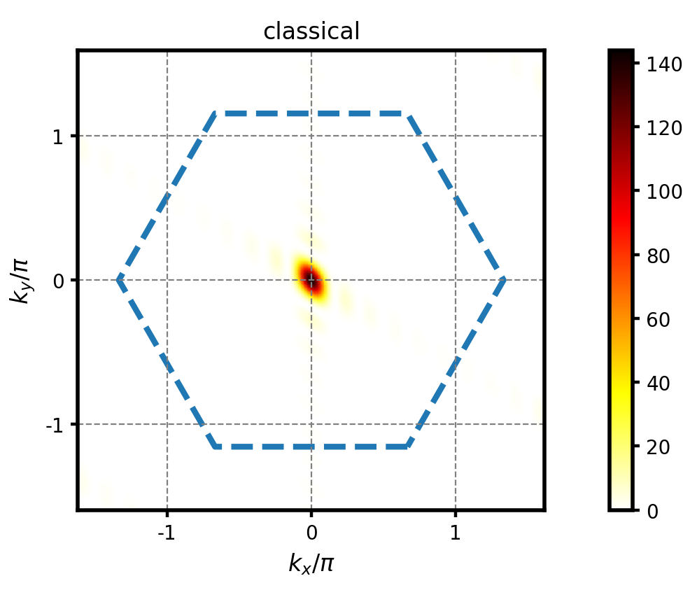
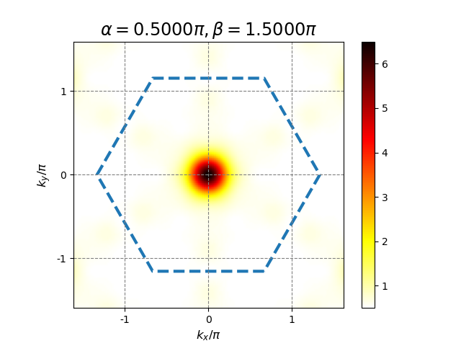


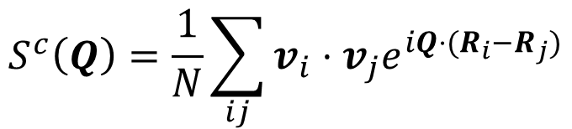
FM-B
$$S^{c}\left(Q\right)=\frac{1}{N}\sum_{ij}{v_{i}⋅v_{j}e^{iQ⋅(R_{i}−R_{j})}}$$

Slide 10
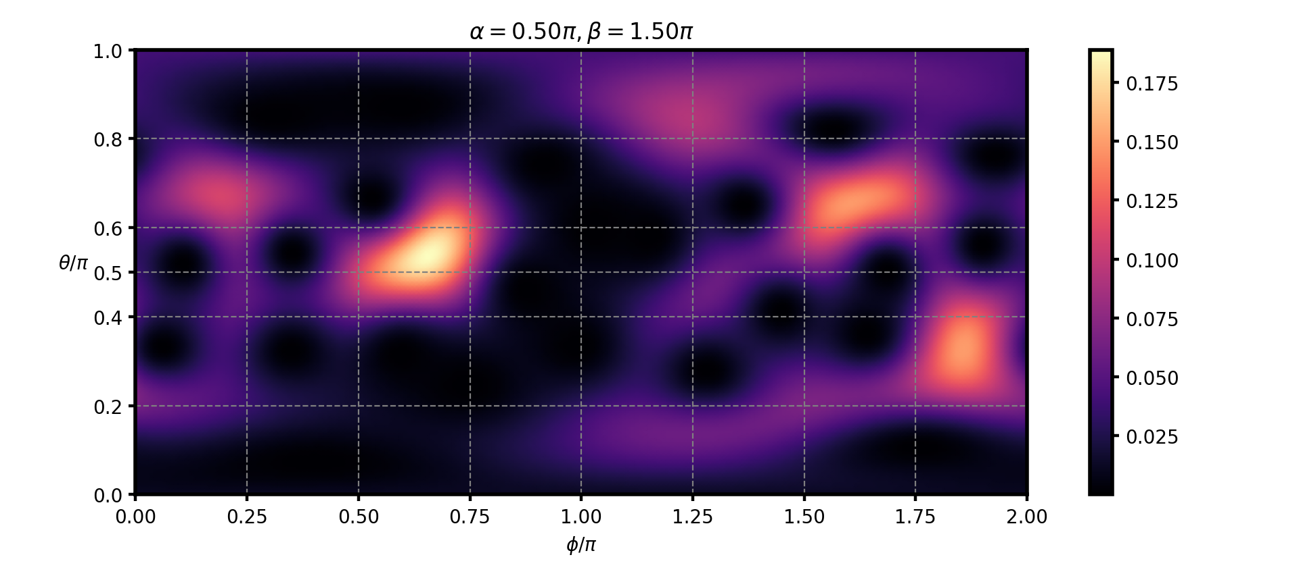
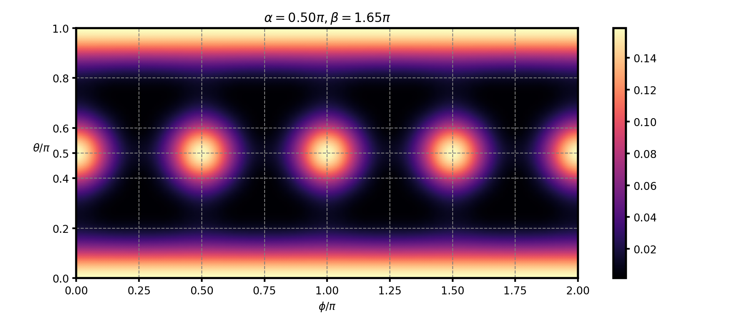
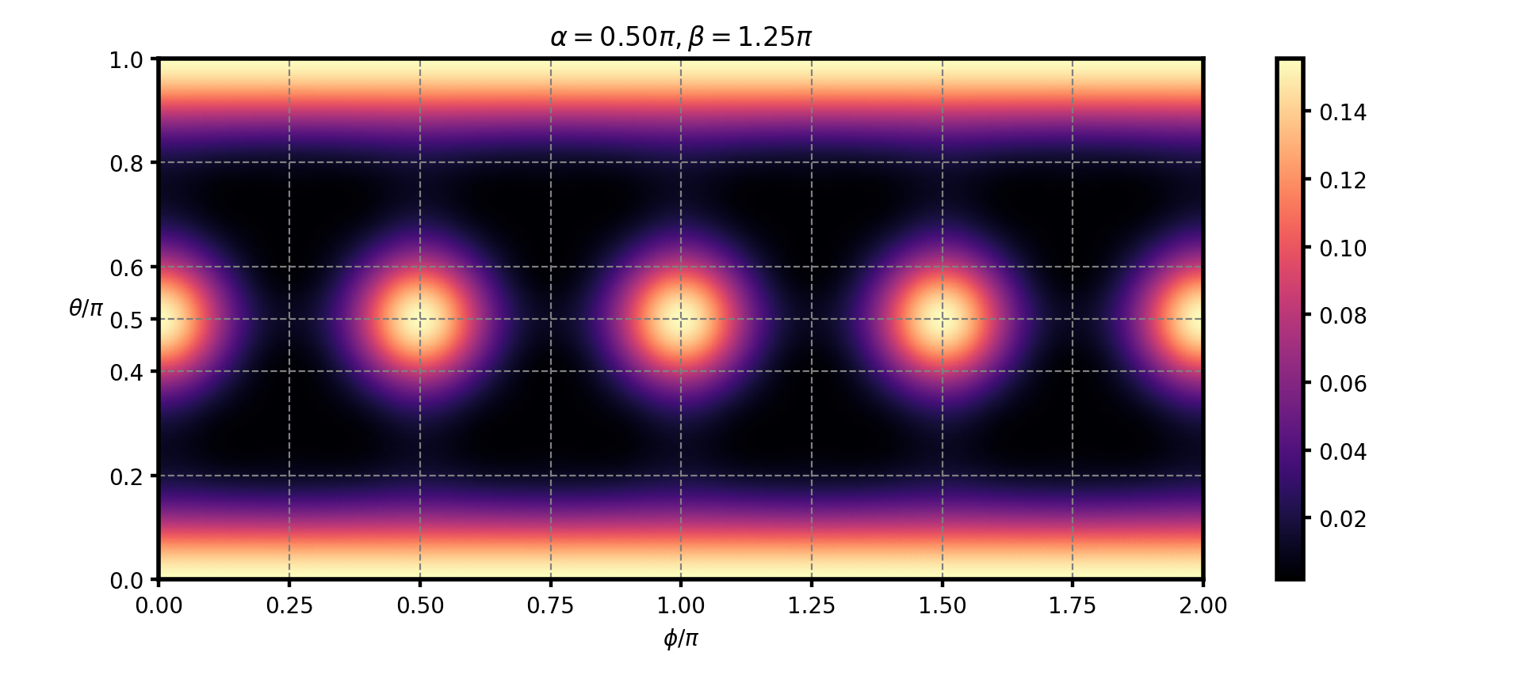
FM-B

Slide 11
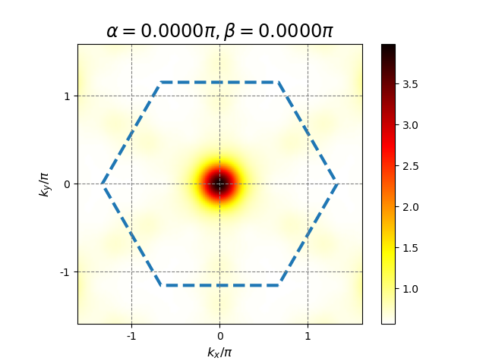
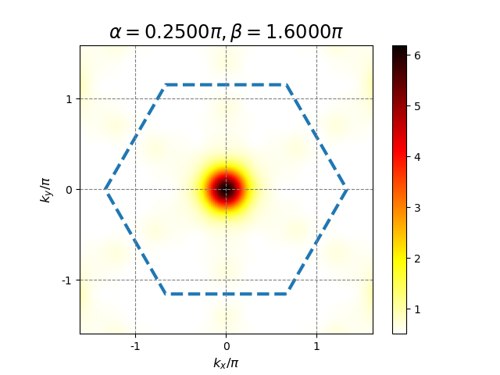

FM-A

Slide 12
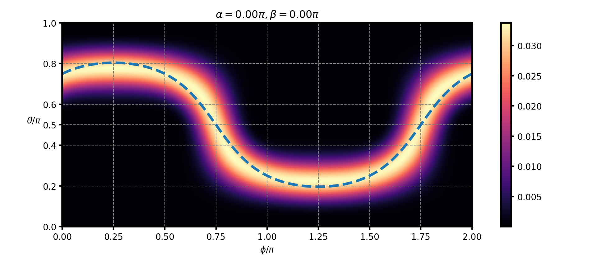
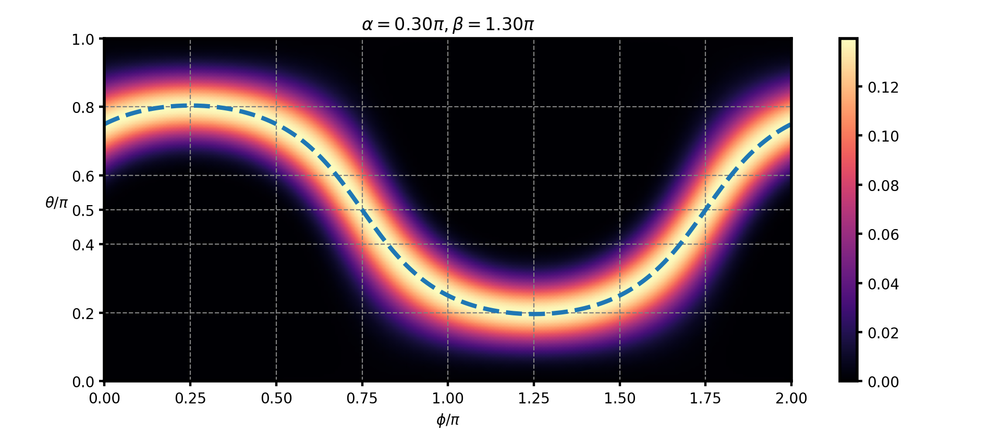
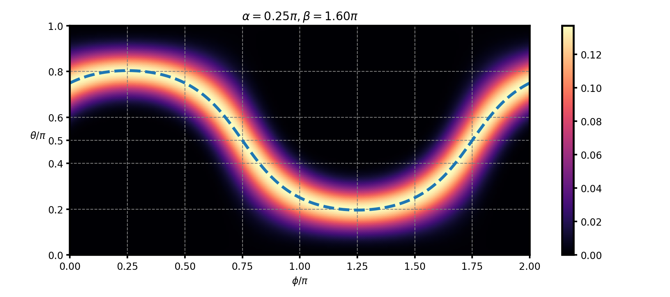
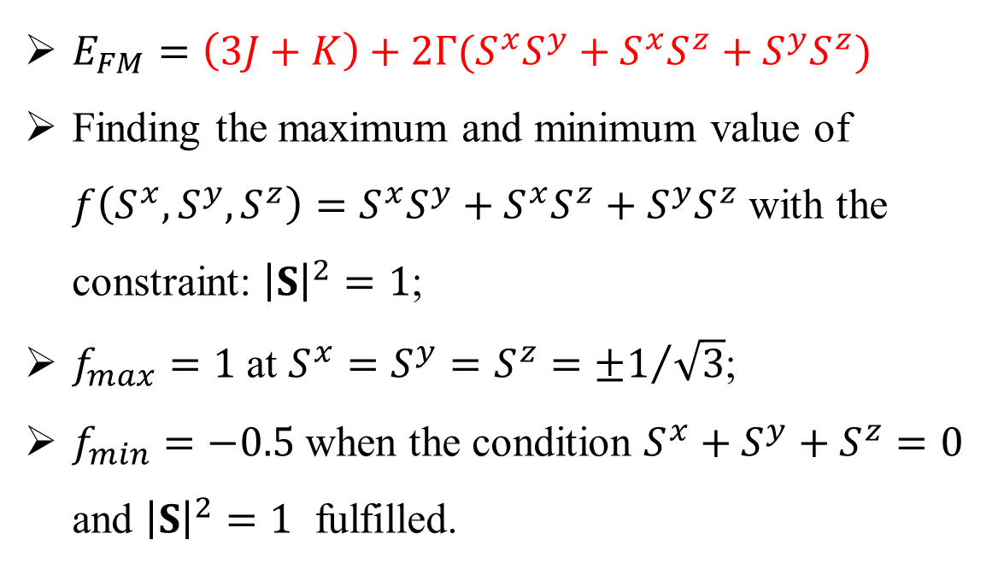
FM-A
$E_{FM}=\left(3J+K\right)+2Γ(S^{x}S^{y}+S^{x}S^{z}+S^{y}S^{z})$
Finding the maximum and minimum value of $f\left(S^{x},S^{y},S^{z}\right)=S^{x}S^{y}+S^{x}S^{z}+S^{y}S^{z}$ with the constraint: ${\left|S\right|}^{2}=1$;
$f_{max}=1$ at $S^{x}=S^{y}=S^{z}={±1}/{\sqrt{3}}$;
$f_{min}=−0.5$ when the condition $S^{x}+S^{y}+S^{z}=0$ and ${\left|S\right|}^{2}=1$ fulfilled.

Slide 13
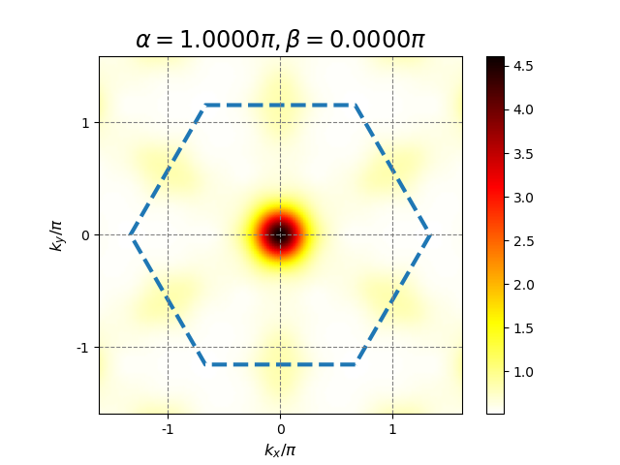


FM-C

Slide 14
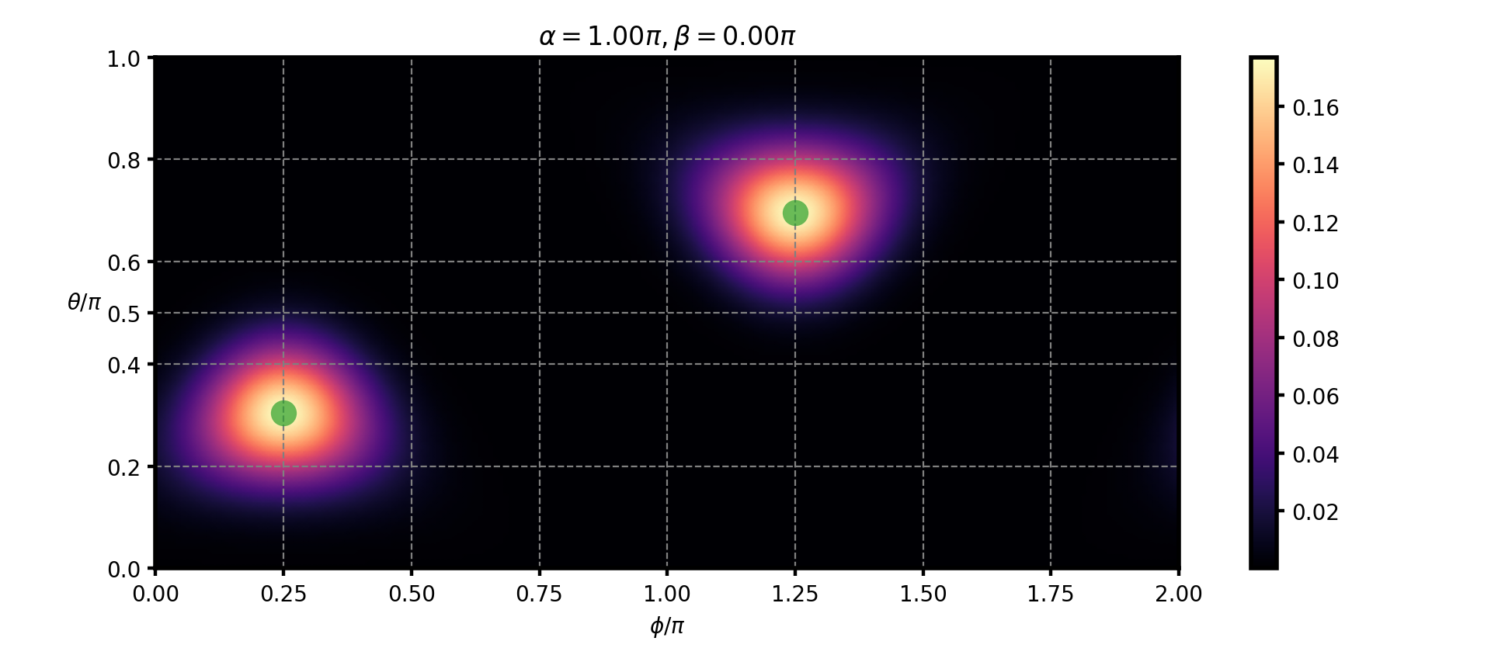
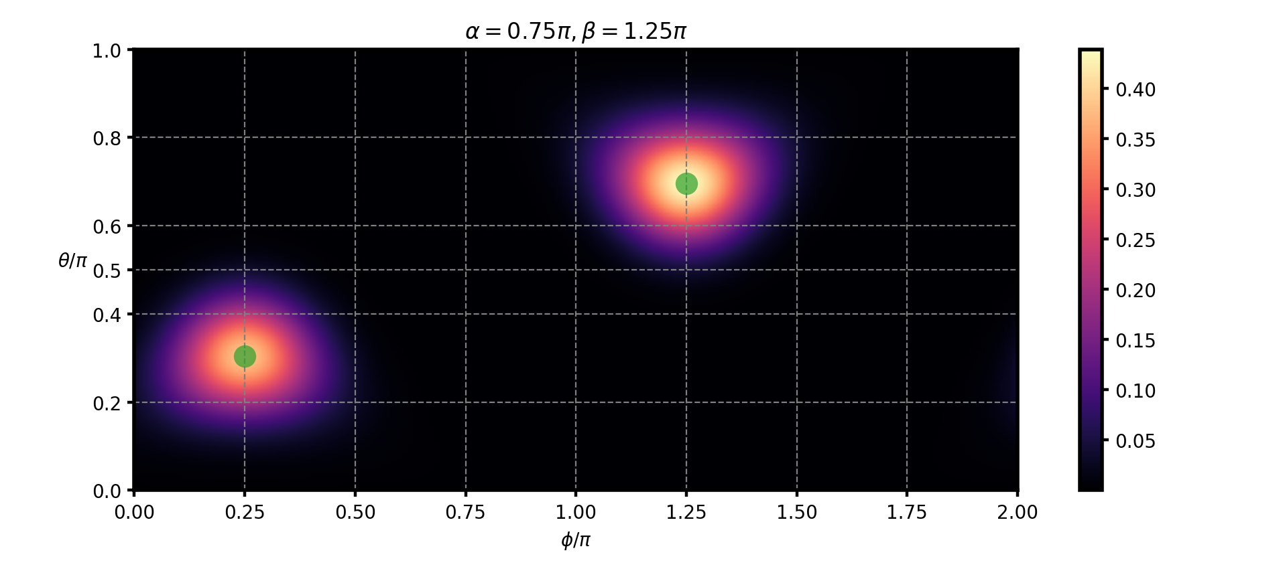
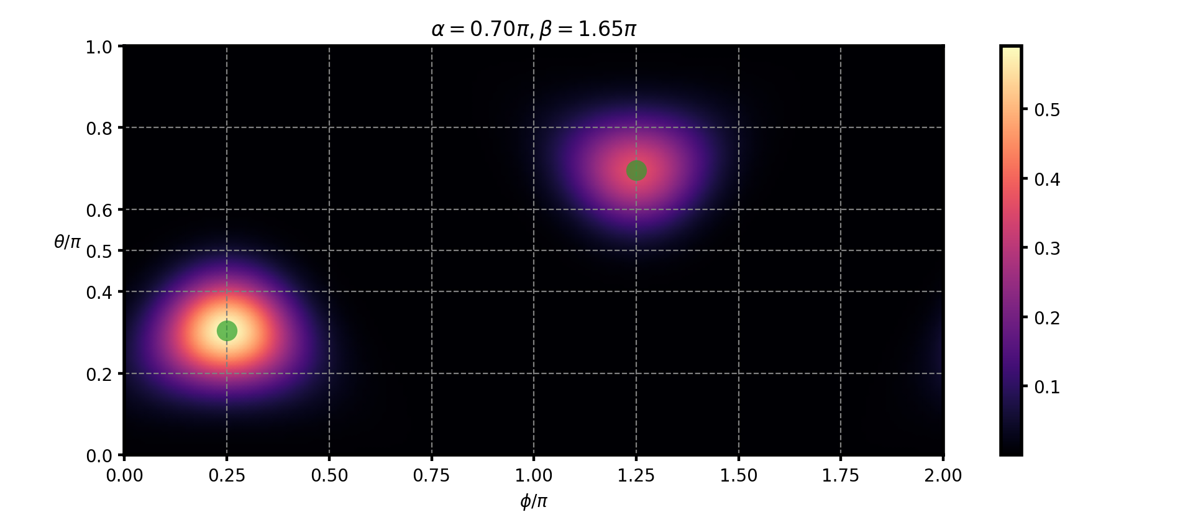
FM-C

Slide 16
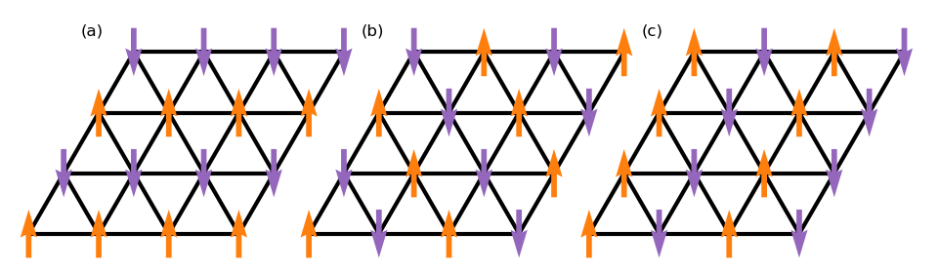
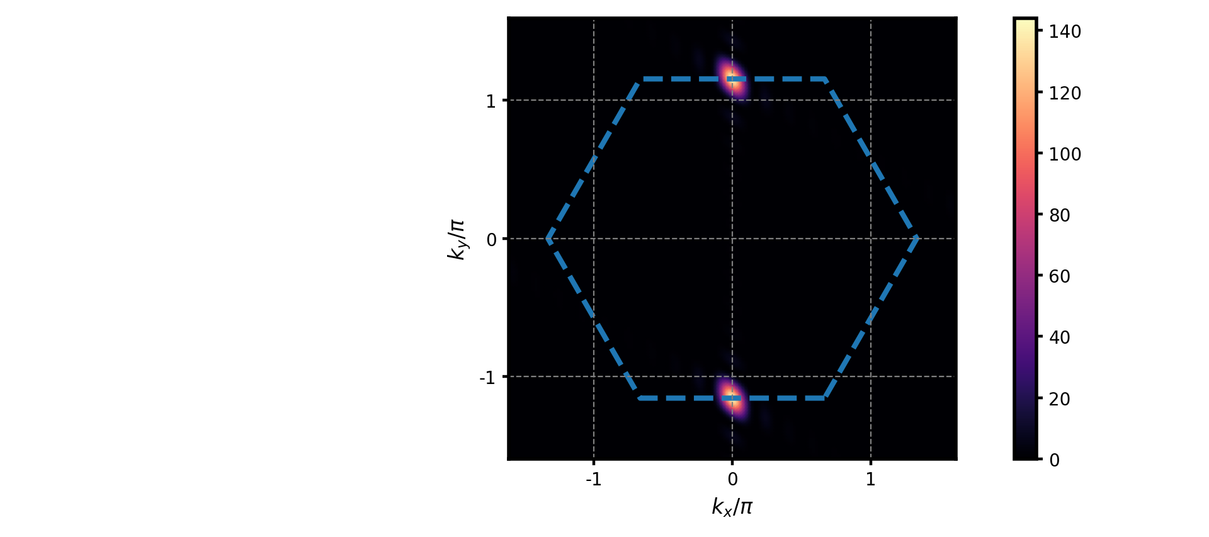
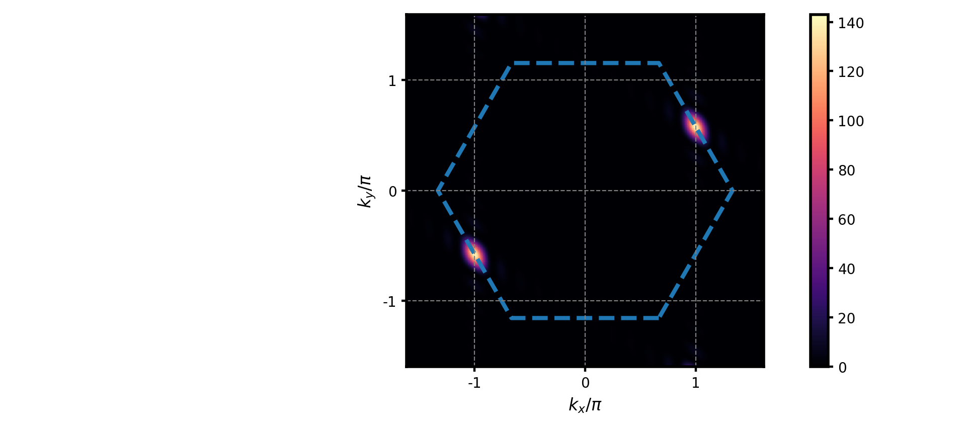

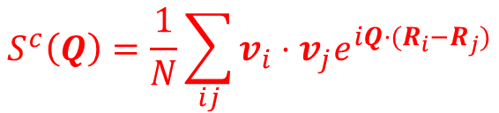
Stripe states
$$S^{c}\left(Q\right)=\frac{1}{N}\sum_{ij}{v_{i}⋅v_{j}e^{iQ⋅(R_{i}−R_{j})}}$$
Config-X
Config-Y
Config-Z

Slide 17
Stripe-A

Slide 18
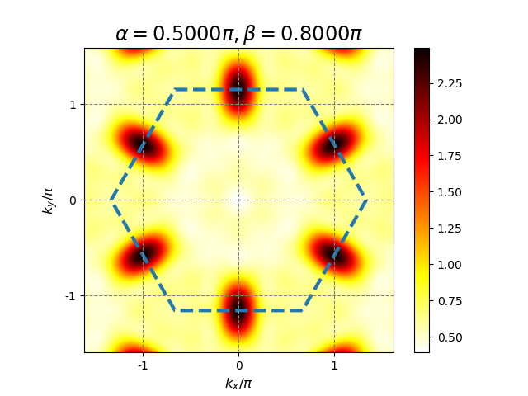
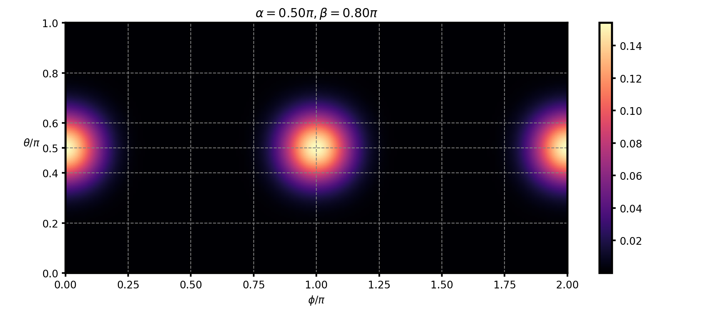
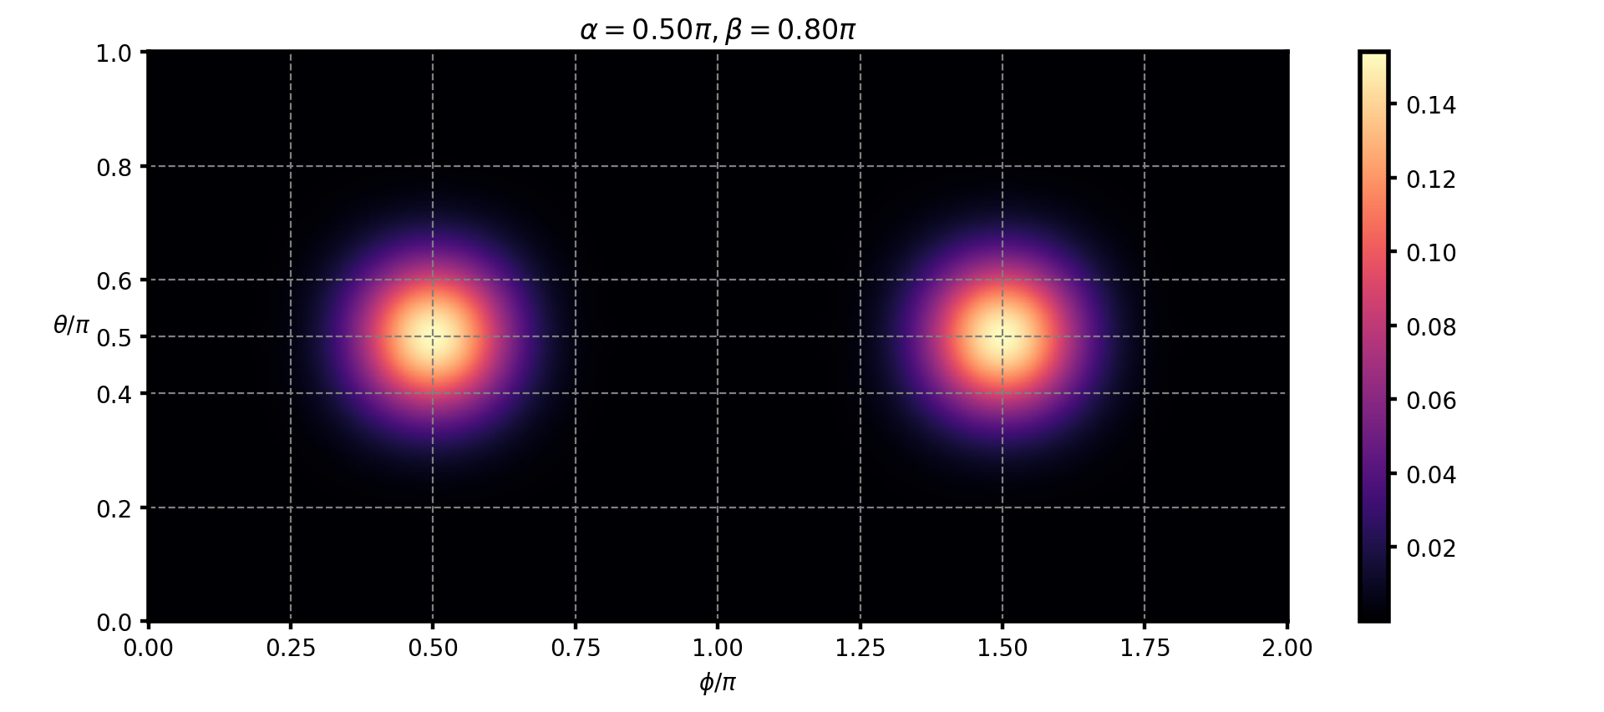
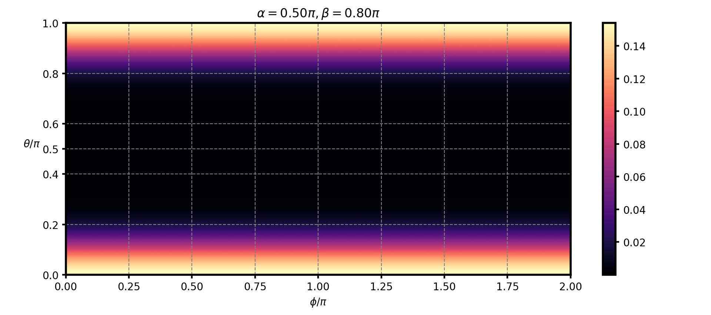
Stripe-A
$$E_{X}^{c}=−\left(J+K\right)+2KS^{x}S^{x}+2Γ(S^{y}S^{z}−S^{x}S^{y}−S^{x} S^{z})$$

Slide 19
Stripe-B

Slide 20
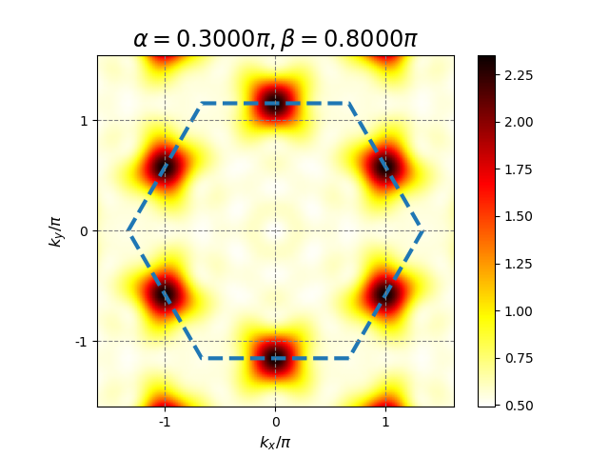
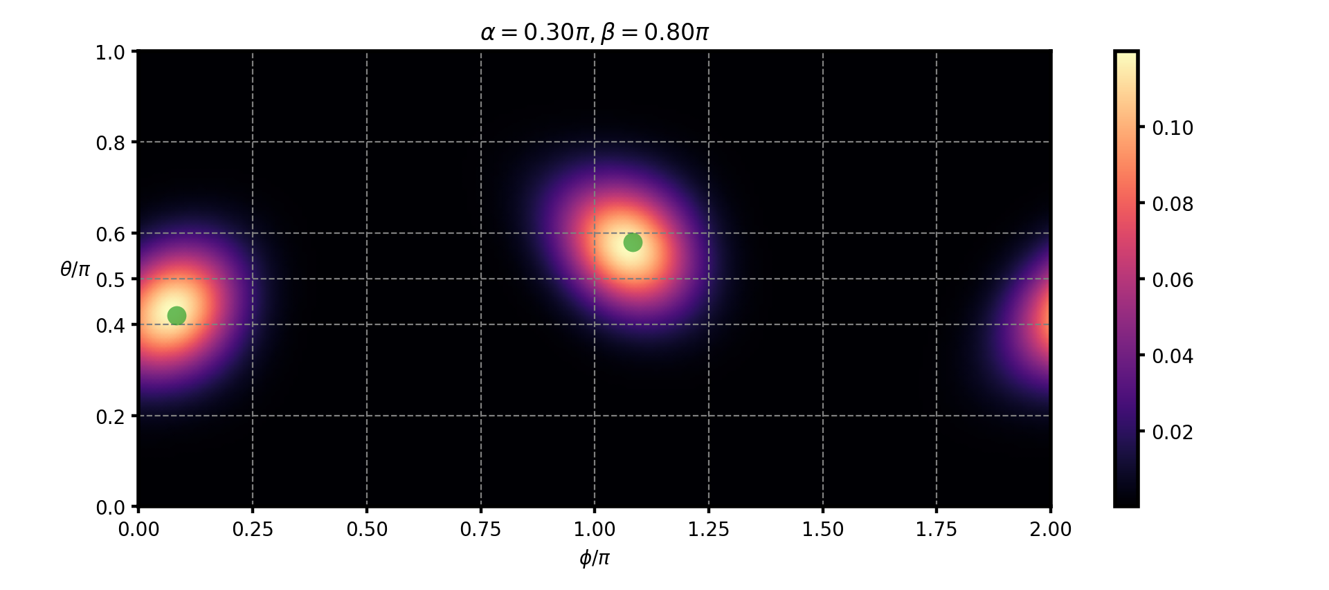
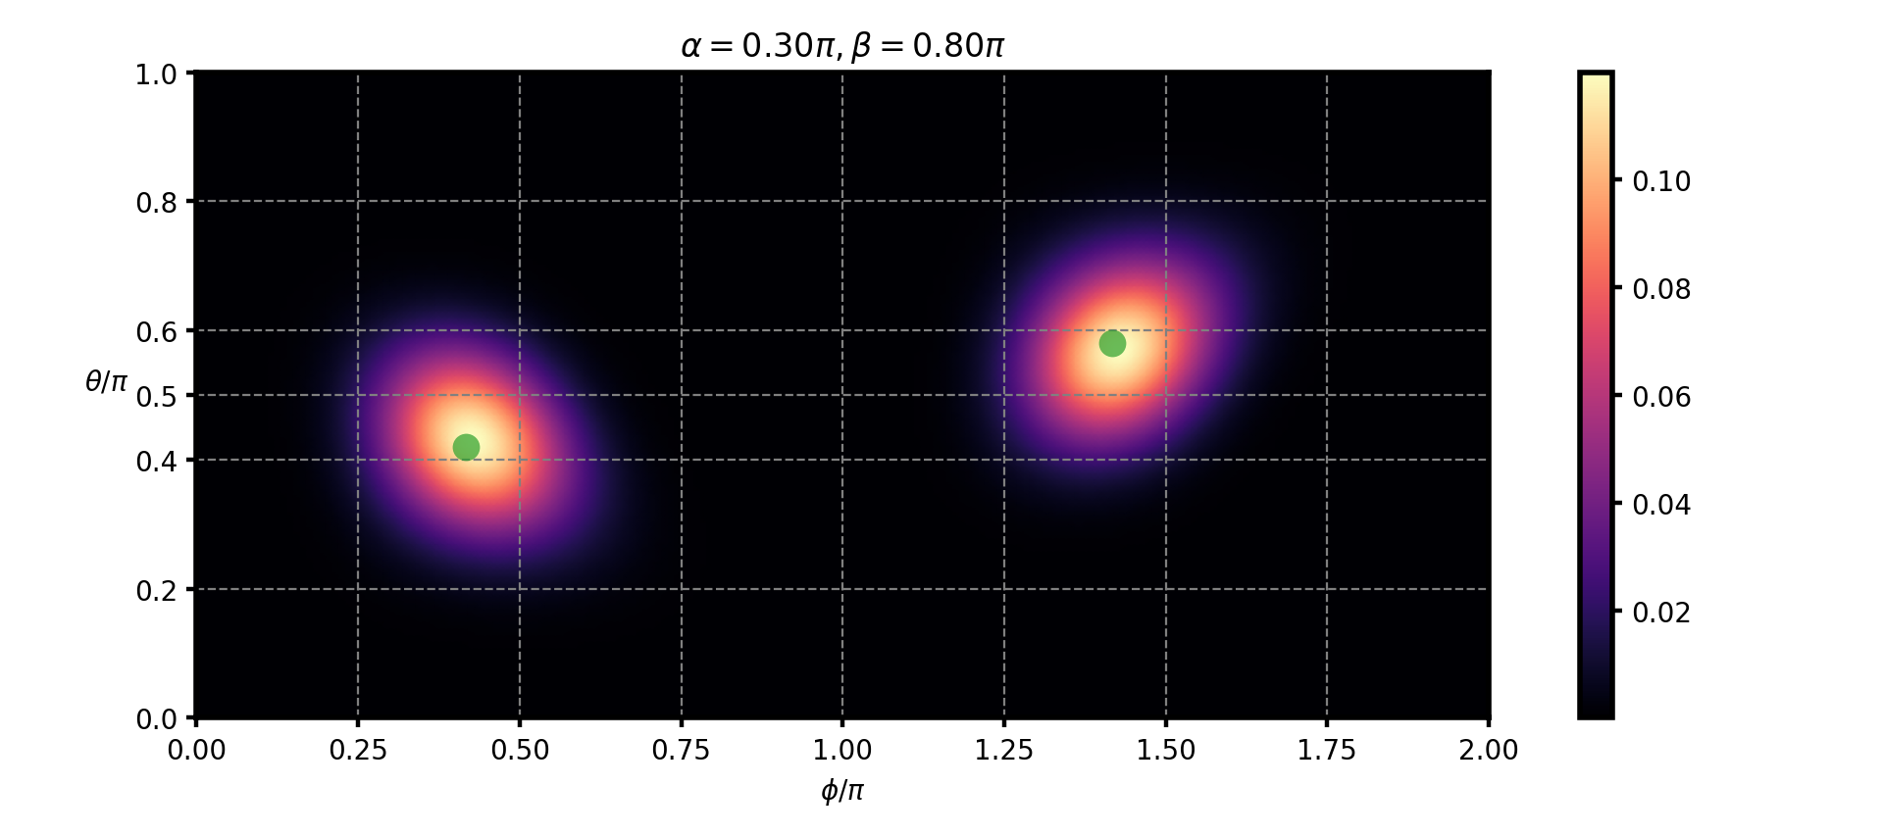
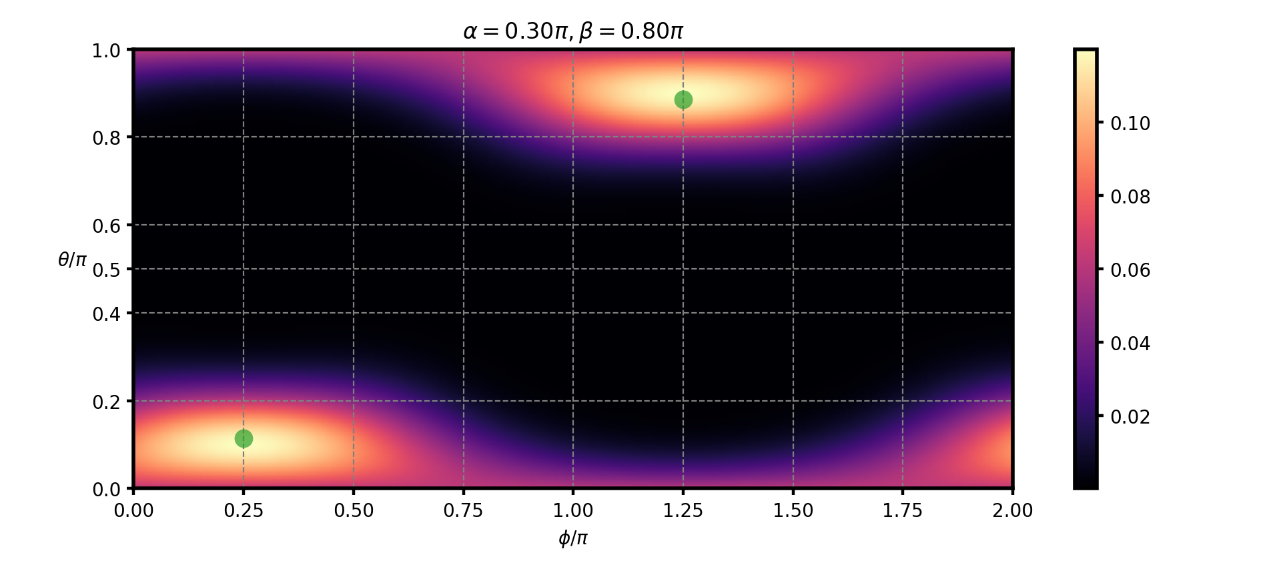
Stripe-B

Slide 21
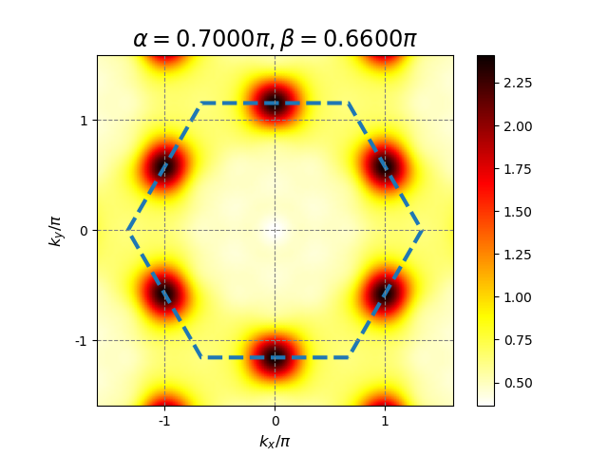
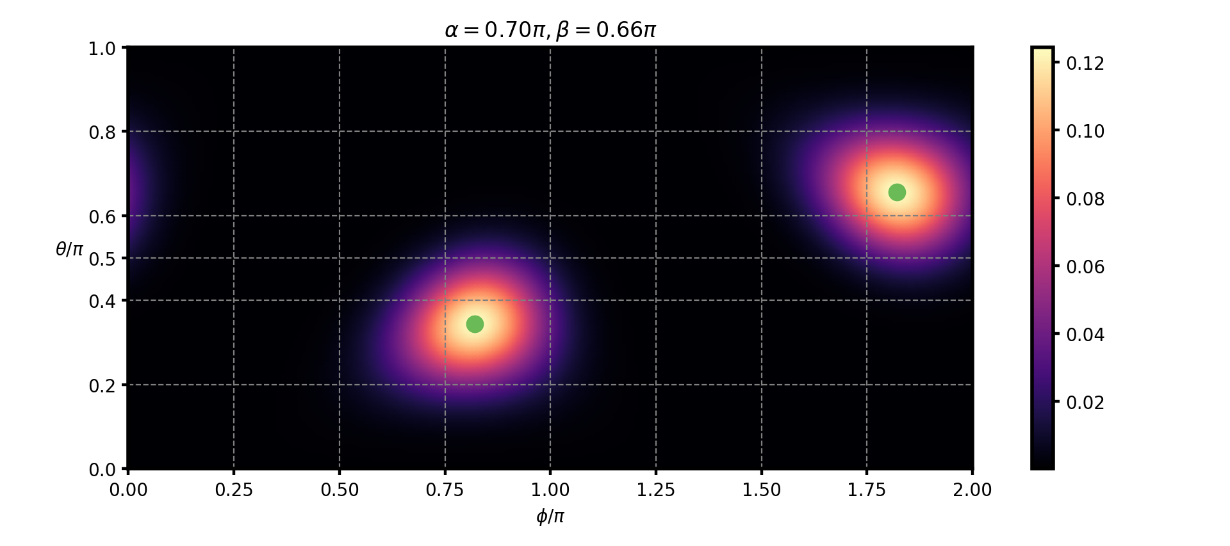
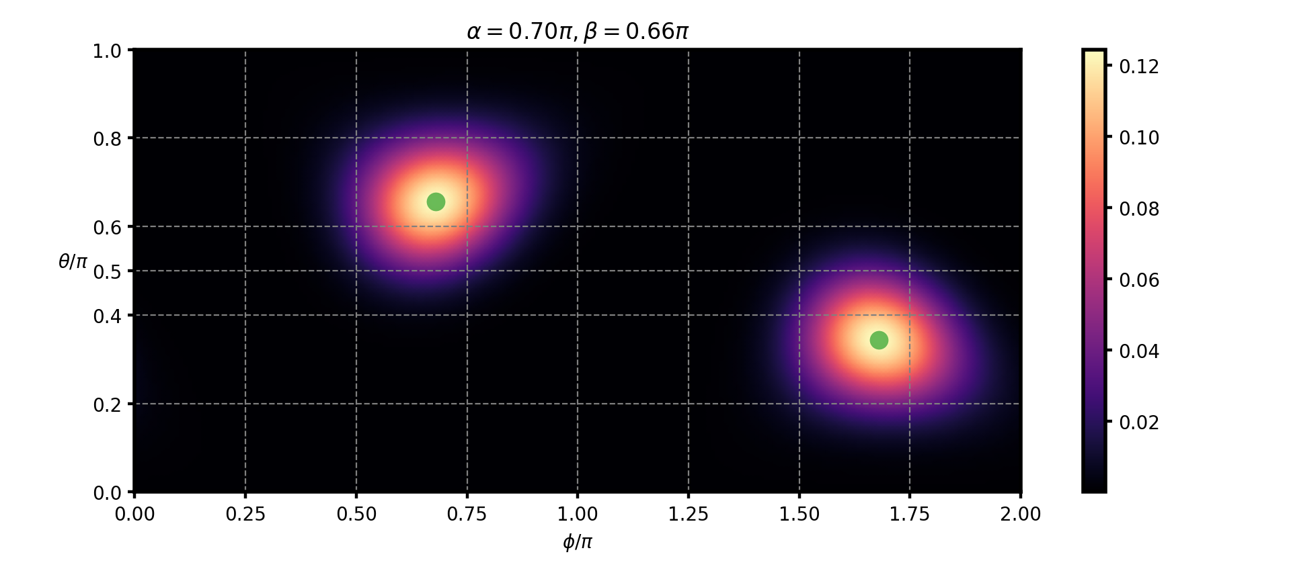
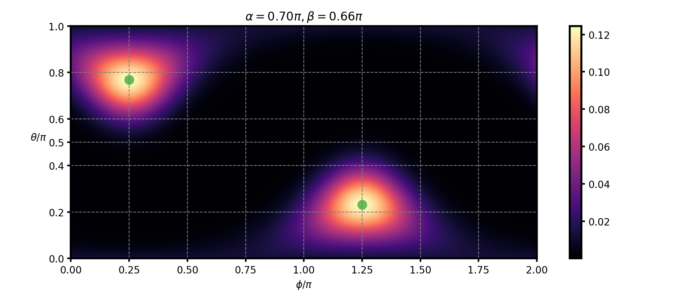
Stripe-B

Slide 22
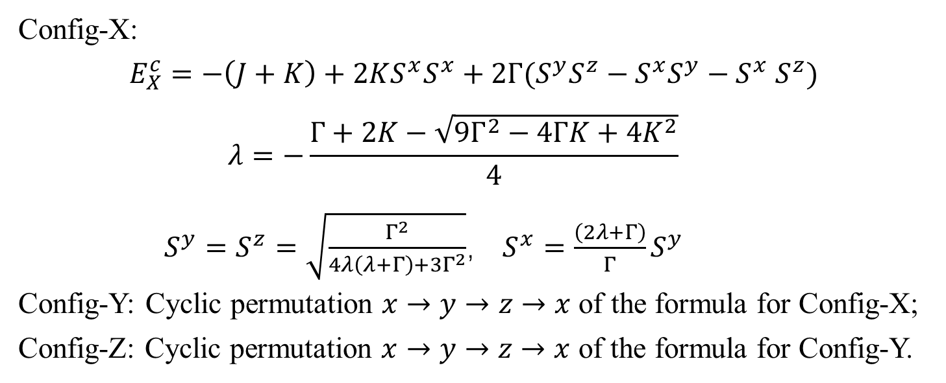
Moment Direction of Stripe-B
Config-X
Config-Y
Config-Z
Config-X:
$$E_{X}^{c}=−\left(J+K\right)+2KS^{x}S^{x}+2Γ(S^{y}S^{z}−S^{x}S^{y}−S^{x} S^{z})$$
$$λ=−\frac{Γ+2K−\sqrt{9Γ^{2}−4ΓK+4K^{2}}}{4}$$
$S^{y}=S^{z}=\sqrt{\frac{Γ^{2}}{4λ\left(λ+Γ\right)+3Γ^{2}}}$， $S^{x}=\frac{\left(2λ+Γ\right)}{Γ}S^{y}$
Config-Y: Cyclic permutation $x→y→z→x$ of the formula for Config-X;
Config-Z: Cyclic permutation $x→y→z→x$ of the formula for Config-Y.

Slide 23
Stripe-C

Slide 24





Stripe-C
$$E_{X}^{c}=−\left(J+K\right)+2KS^{x}S^{x}+2Γ(S^{y}S^{z}−S^{x}S^{y}−S^{x} S^{z})$$
takes minimum values at $S^{x}=0, S^{y}=−S^{z}$.

Slide 25
Stripe-D

Slide 26





Stripe-D
$$E_{X}^{c}=−\left(J+K\right)+2KS^{x}S^{x}+2Γ(S^{y}S^{z}−S^{x}S^{y}−S^{x} S^{z})$$
takes minimum values at $S^{x}=0$.

Slide 27
Possible QSL

Slide 28



Possible QSL

Slide 29

$120°$ Neel

Slide 30



Ground State of $Γ=1$
For $J=K=0,Γ=1$, apart from the FM order lie in the plane perpendicular to the [111] direction, we also found disordered states which have the same energy as the FM state but no states with lower energy were found.

Slide 31
Ground State of $Γ=1$

Slide 32





Ground State of $Γ=−1$
For $J=K=0,Γ=−1$, we found several energetically degenerate states as the classical ground state, including FM state, stripe states and a noncollinear state.
Cyan: [-111]
Pink: [1-11]
Yellow: [11-1]
Gray: [111]

Slide 33
Ground State of $Γ=−1$

Slide 34

Ground State of $K=1$

Slide 35
Ground State of $K=1$

Slide 36
Ground State of $K=−1$
Config-X
Config-Y
Config-Z

Slide 37





Ground State of $K=−1$

Slide 38

Summary
Diagonalize the model Hamiltonian on a finite cluster with periodic boundary condition;
The phase boundaries are obtained from the location of singular features in second derivatives of $E_{0}$ versus model parameters;
Perform classical analysis and calculate the SMSF to determine the possible magnetic order;
Measure the presence of the magnetically ordered states by using cluster spin-coherent state;
Calculate spin-excitation spectrum using Lanczos algorithm.

Slide 39
Thank you!

